Slide 1
Visualization of phylogenetic trees with SNPs from VCF file
Team members:
Christian Zmasek (czmasek@jcvi.org)- Team leader
Chrissy Aceves (caceves@scripps.edu)
Nate Matteson (natem@scripps.edu)
Grace Nabakooza (sxv8@cdc.gov)
Daniel Chen (dchen32@uw.edu)
Diana Ir (diana.ir@state.co.us)
Notes:
Christian

Slide 2
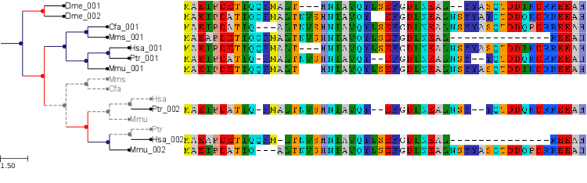
Background/Goal
Numerous software tools and resources for the combined visualization of phylogenetic trees and the underlying multiple sequence alignment (MSA) exist.
Example: ETE toolkit (http://etetoolkit.org/)
Notes:
Christian

Slide 3
Background/Goal
Existing tools display all position in multiple sequence alignment
SARS-CoV-2 genomes are long and majority of position are identical in all genomes/variants
Therefore, we decided to explore the possibility of a tool which only displays positions which are different between genomes and which takes Variant Call Format as input
Notes:
Christian

Slide 4
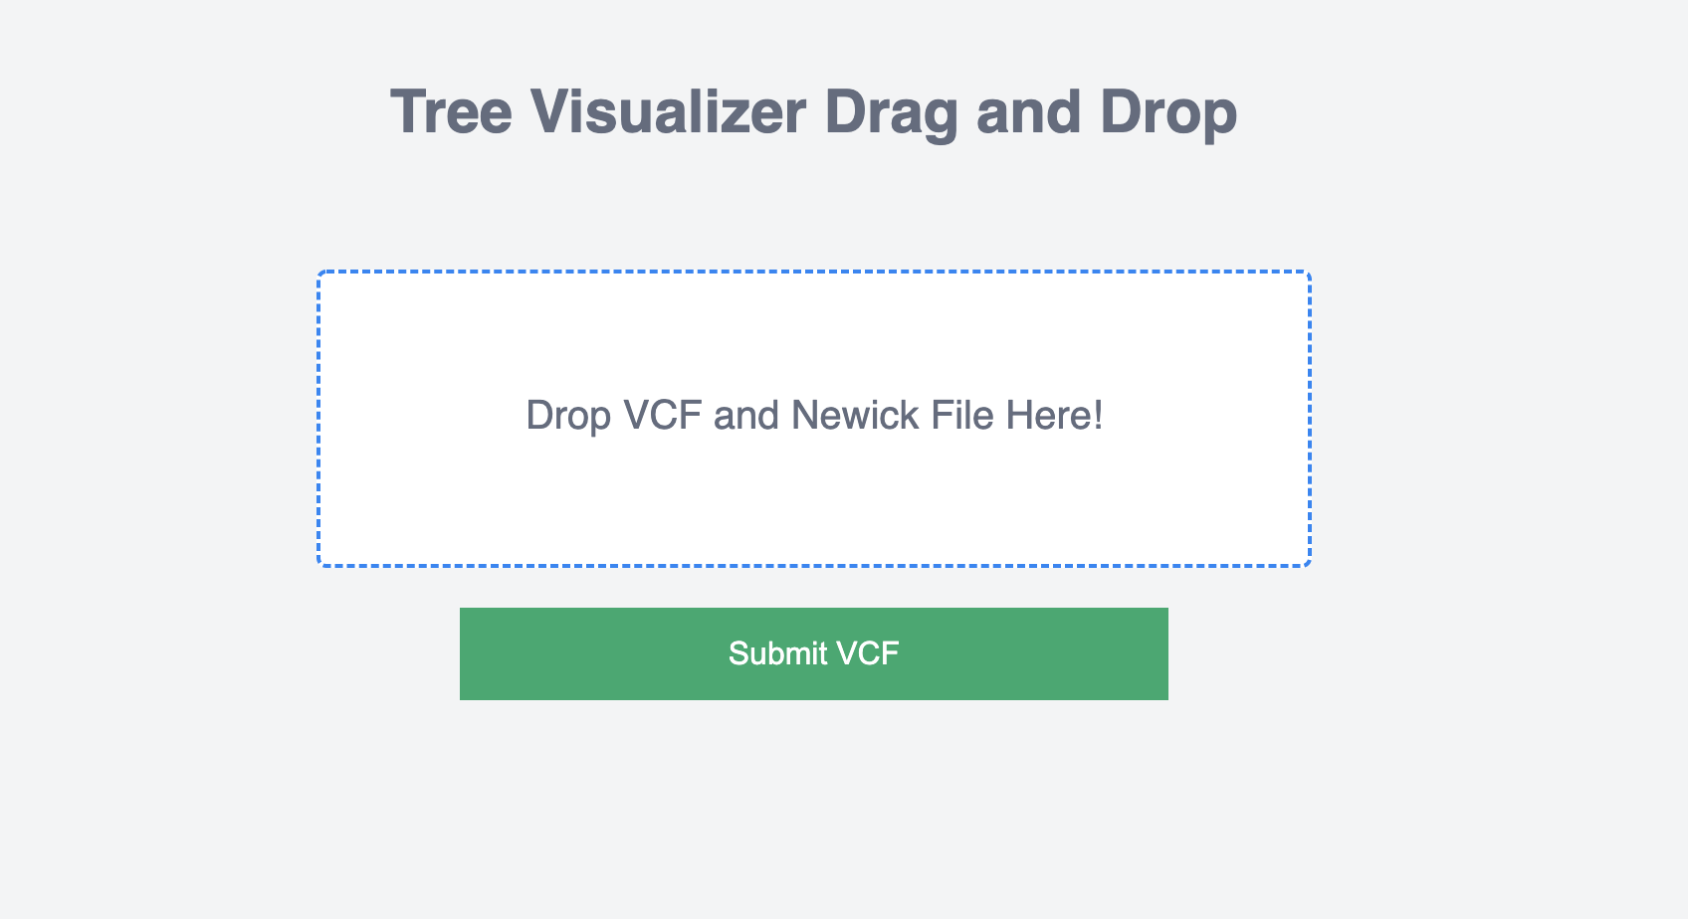
Upload files to website
Notes:
Chrissy, if not available then Daniel

Slide 5
Linked phylogeny and concise alignment
Notes:
Nate. Once uploaded, our tool displays the uploaded phylogenetic tree and a concise alignment made from the VCF file containing only reference positions which are variable among the sequences in the tree.
All trees being shown are a tree of 200 SARS-CoV-2 sequences subsampled from GISAID. Alignment was downloaded from GISAID, and the tool faToVcf (provided as part of USHER) was used to generate a VCF from the alignment. Tree building was then performed with augur which wraps IQTree2 and allows reconstruction of a phylogeny from a VCF file.

Slide 6
Concise alignment reflects visible taxa
Notes:
Nate. Alignment only displays positions that are variable to the reference for any taxa shown. Zooming into a clade showns only the relevant positions.

Slide 7
Fixing React-MSA’s position labeling to reflect residues
Notes:
Nate.

Slide 8
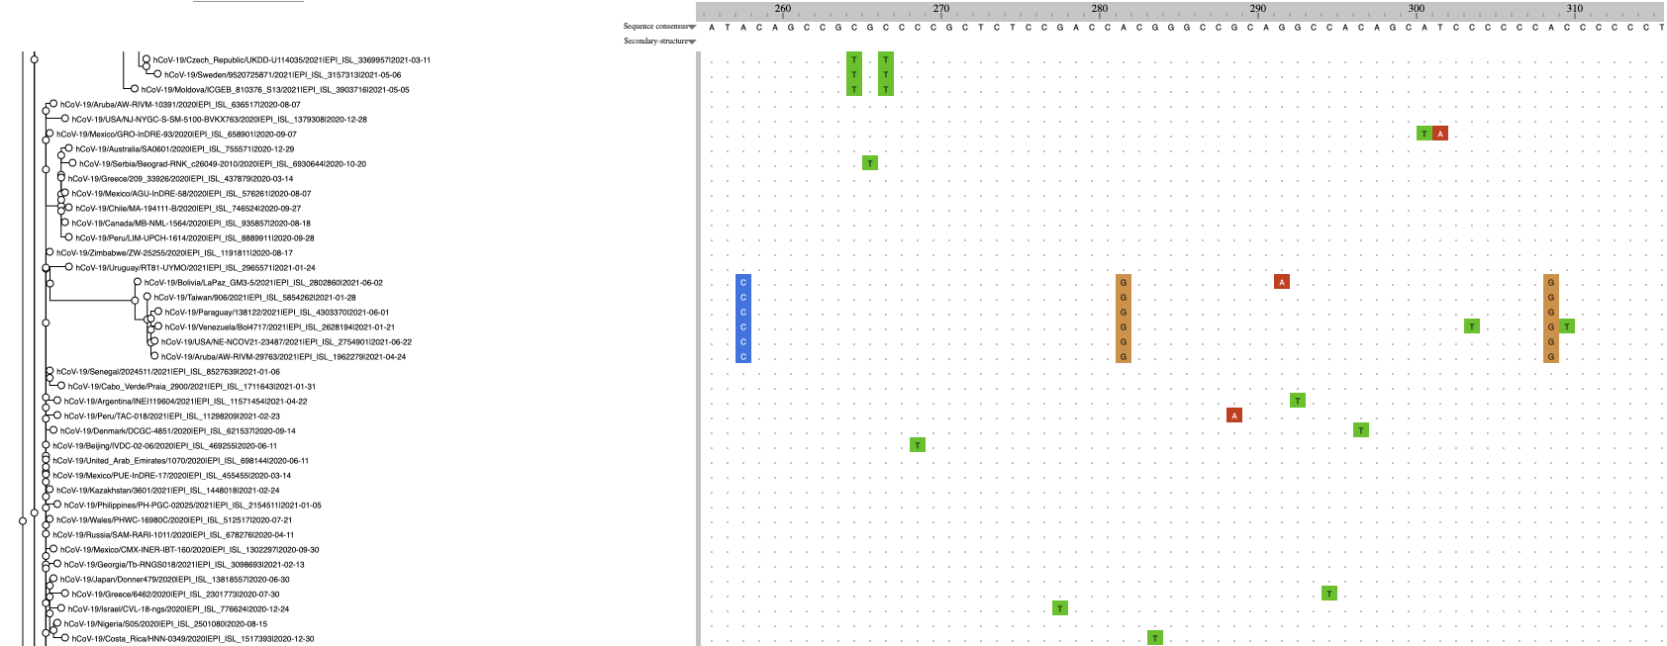
Identify clade defining substitutions
A5648C
A6319G
A6613G
Notes:
Nate. Clade shown is P.1. Relatively easy to see that some of the clade defining mutations are. Only the first of the mutations shown is nonsynonymous: NSP3: K977Q.

Slide 9
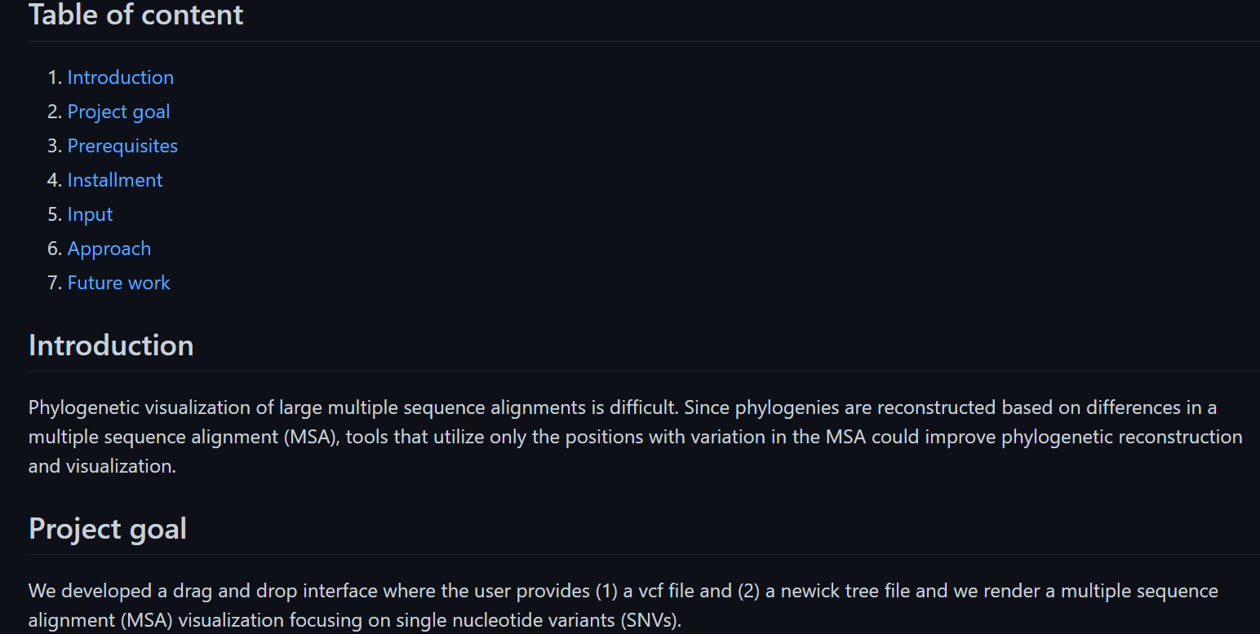
README.md
Notes:
Daniel

Slide 10
Future directions
Summarize nucleotides at each reference position
Provide more information about each substitution
Real-time calculation of clade-defining substitution
Annotate phylogeny with useful metadata
Infer/visualize mutations in internal nodes, using standard approaches for ancestral sequence reconstruction (i.e. maximum likelihood or maximum parsimony)
Allow other MSA input formats (FASTA, PHYLIP) as input and calculate SNPs
Notes:
Daniel

Slide 11
Software availability
https://github.com/NCBI-Codeathons/beyond-phylogenies-team3
Notes:
Daniel

